Slide 1
Data Intelligence Applications
Pricing and Matching project – A.Y. 2020/2021
Group: Letizia Brambilla, Francesca Pietrobon, Diego Savoia, Francesco Emanuele Stradi

Slide 2


Scenario: Items
Apple Watch (€300)
Personalized wristband (€50)

Slide 3

Scenario: Customer classes
Class 1: females up to 35 years old
Class 2: males up to 35 years old
Class 3: females
older than 35 years old
Class 4: males
older than 35 years old

Slide 4
Scenario: Promos
Promo P0
No discount
Promo P1
10% discount
Promo P2
20% discount
Promo P3
50% discount

Slide 5

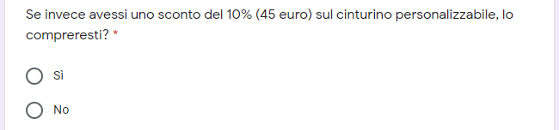
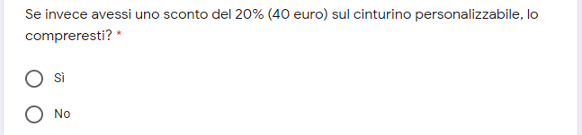
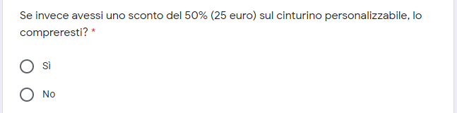
Google Form

Slide 6
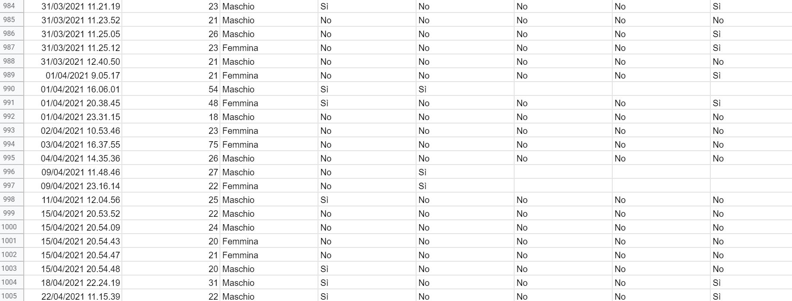
Google Form

Slide 7
Google Form
Conversion rates of the first item
Conversion rates of the second item
Average number of daily customers

Slide 8
Disclaimer
Promos are received by all the customers that purchase the first item. Giving promo P0 means that the specific customer does not receive a discount.
In the project steps we considered vectors of candidate prices (and margins) for both the items, and related vectors of conversion rates, starting from the form data. Therefore, the optimal prices found in the project steps will not be necessarily the ones proposed in the form.

Slide 9
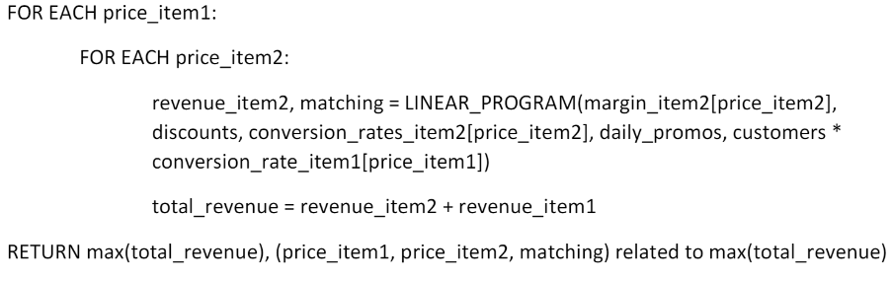
Step 1: Algorithm

Slide 10
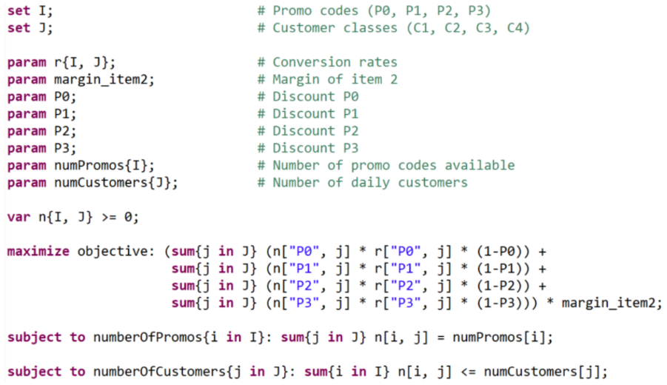
Step 1: Linear Program

Slide 11
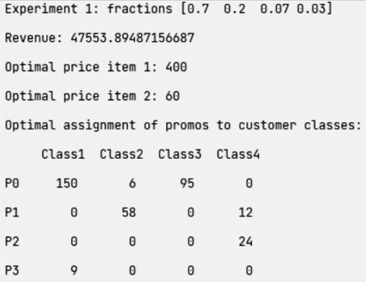
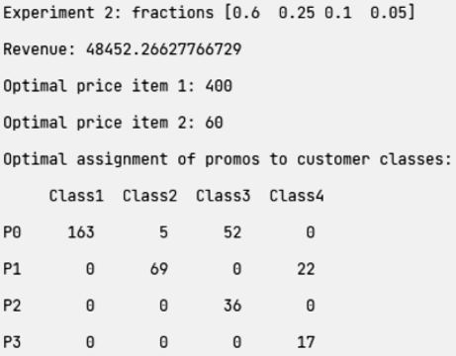
Step 1: Results

Slide 12
Step 2: General idea
For each round:
Update the estimation of the conversion rates, optimal prices, and daily customers.
Solve the linear program.
Normalize the resulting matrix of the matching.
Assign promos to the customers of the next day using the previously computed normalized matrix.

Slide 13
Step 2: Environment
For each customer:
A new customer of a specific class arrives.
Extraction from a Bernoulli distribution with p=conversion rates for the first item to understand if the customer buys the first item.
Assignment of a promo to the customer using a discrete distribution according to the weights of the matching.
Extraction from a Bernoulli distribution with p=conversion rates for the second item to understand if the customer buys the second item.
Computation of the daily conversion rates for both the items and the daily revenue.

Slide 14
Step 3: Model
UCB1:
Arms: margins of the first item.
Empirical mean: estimation of the conversion rates of the first item.
Confidence: standard confidence of the UCB1 Bandit.
Upper bound: revenue given the estimation of the conversion rates of the first item (empirical mean plus confidence) and the known optimal parameters received as inputs.

Slide 15
Step 3: Model
Thompson Sampling:
Arms: margins of the first item.
Beta distribution: standard Beta distribution of the Thompson Sampling Bandit related to the conversion rates of the first item.
Pulled arm: based on the revenue given the estimation of the conversion rates of the first item (extraction from Beta distribution) and the known optimal parameters received as inputs.

Slide 16
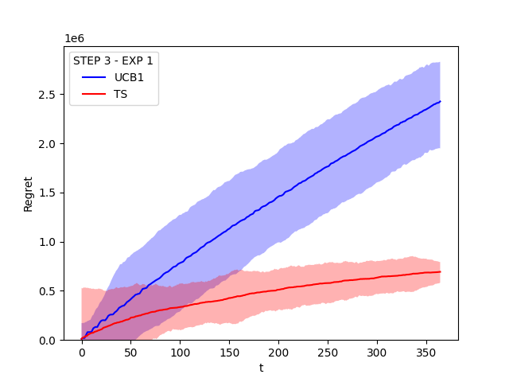
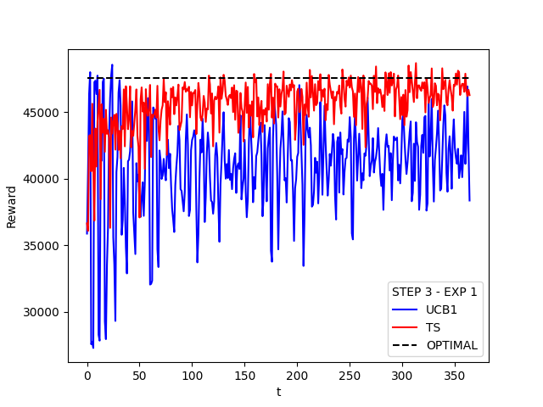
Step 3: Results (first experiment)
T = 365 days

Slide 17
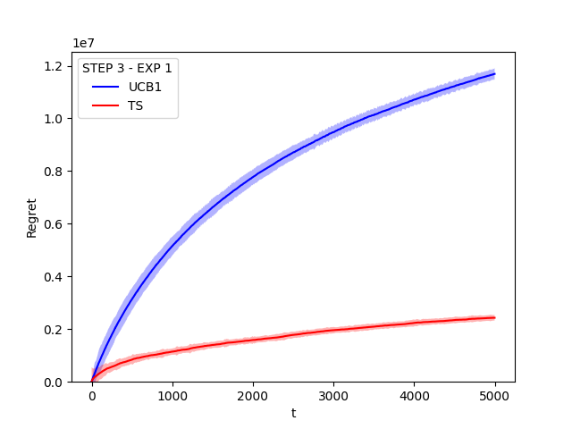
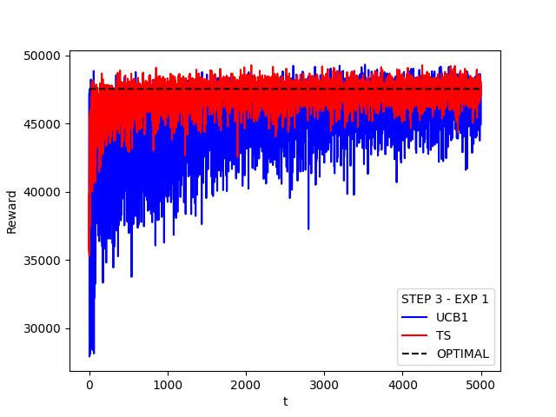
Step 3: Results (first experiment)
T = 5000 days

Slide 18
Step 3: Results (second experiment)
T = 365 days

Slide 19
Step 3: Results (second experiment)
T = 5000 days

Slide 20
Step 4: Model
UCB1:
Arms: margins of the first item.
Empirical mean: estimation of the conversion rates of the first item.
Confidence: standard confidence of the UCB1 Bandit.
Upper bound: revenue given the estimation of the conversion rates of the first item (empirical mean plus confidence), the estimation of the conversion rates of the second item (computing the mean of the daily conversion rates of the previous rounds) and number of customers (computing the mean of the daily customers of the previous rounds), and the known optimal parameters received as inputs.

Slide 21
Step 4: Model
Thompson Sampling:
Arms: margins of the first item.
Beta distribution: standard Beta distribution of the Thompson Sampling Bandit related to the conversion rates of the first item.
Pulled arm: based on the revenue given the estimation of the conversion rates of the first item (extraction from Beta distribution), the estimation of the conversion rates of the second item (computing the mean of the daily conversion rates of the previous rounds) and number of customers (computing the mean of the daily customers of the previous rounds), and the known optimal parameters received as inputs.

Slide 22
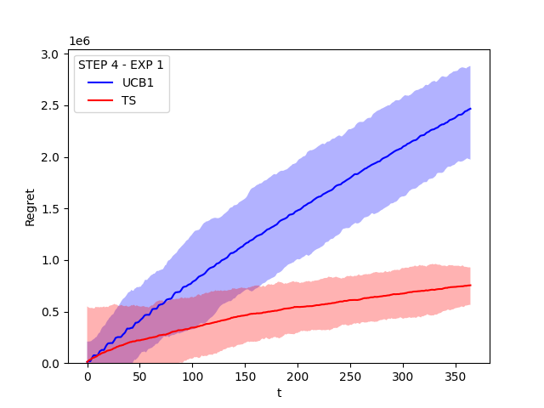
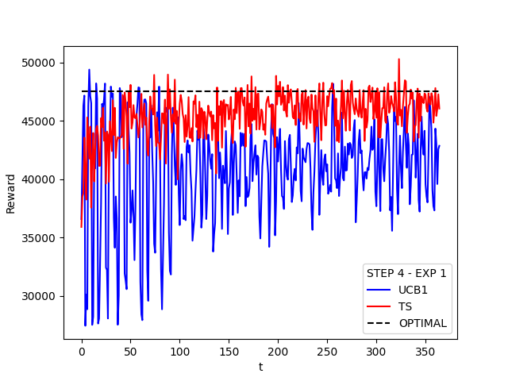
Step 4: Results (first experiment)
T = 365 days

Slide 23
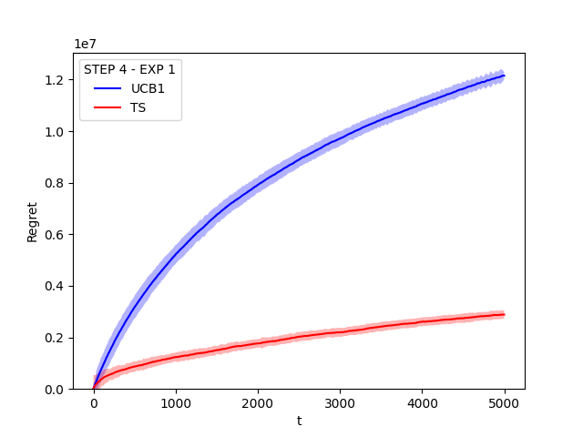
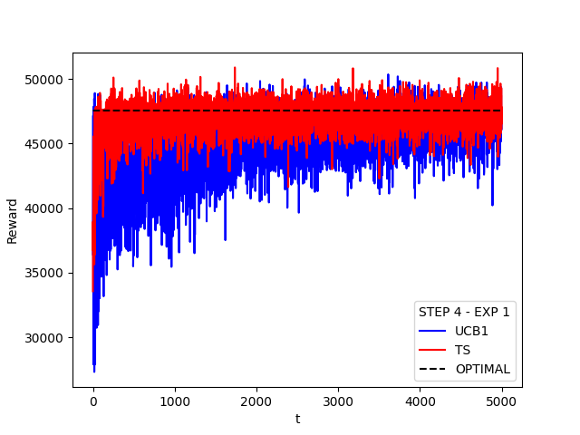
Step 4: Results (first experiment)
T = 5000 days

Slide 24
Step 4: Results (second experiment)
T = 365 days

Slide 25
Step 4: Results (second experiment)
T = 5000 days

Slide 26
Step 5: Model
The number of daily customers is learned as the mean of the number of daily customers arrived in the past.
The conversion rates of the first item are learned as the mean of the conversion rates of the first item observed in the past.
The conversion rates of the second item are learned as the mean of the conversion rates of the second item observed in the past.
Every day, the linear program is run using the mean of daily customers and conversion rates and the optimal prices given in input.

Slide 27
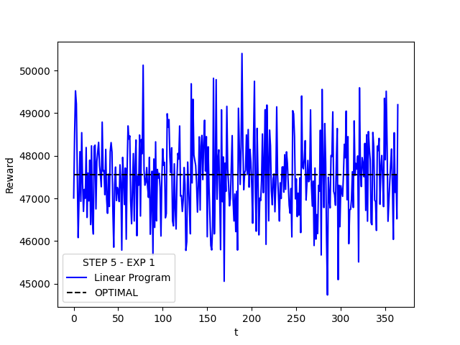
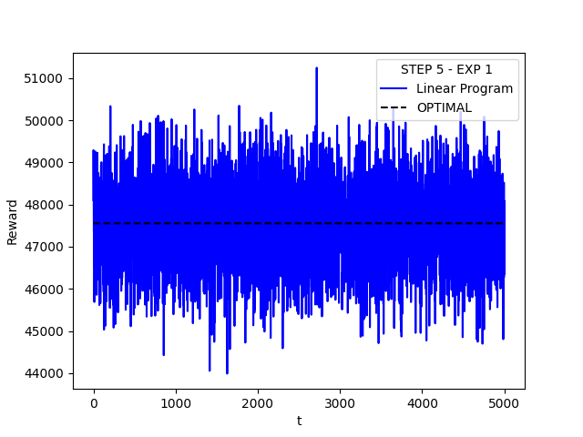
Step 5: Results (first experiment)
T = 365 days
T = 5000 days

Slide 28
Step 5: Results (second experiment)
T = 365 days
T = 5000 days

Slide 29
Step 6: Model
UCB1:
Arms: cross-product of the margins of the two items.
Empirical mean first item: estimation of the conversion rates of the first item.
Empirical mean second item: estimation of the conversion rates of the second item.
Confidence first item: standard confidence of the UCB1 Bandit related to the first item.
Confidence second item: standard confidence of the UCB1 Bandit related to the second item.
Upper bound: revenue given the estimation of the conversion rates of the first item (empirical mean first item plus confidence first item), the estimation of the conversion rates of the second item (empirical mean second item plus confidence second item), the number of customers (computing the mean of the daily customers of the previous rounds) and the assignment computed by the linear program for each pair of prices.

Slide 30
Step 6: Model
Thompson Sampling:
Arms: cross-product of the margins of the two items.
Beta distribution first item: standard Beta distribution of the Thompson Sampling Bandit related to the conversion rates of the first item.
Beta distribution second item: standard Beta distribution of the Thompson Sampling Bandit related to the conversion rates of the second item.
Pulled arm: revenue given the estimation of the conversion rates of the first item (extraction from Beta distribution first item), the estimation of the conversion rates of the second item (extraction from Beta distribution second item), the number of customers (computing the mean of the daily customers of the previous rounds) and the assignment computed by the linear program for each pair of prices.

Slide 31
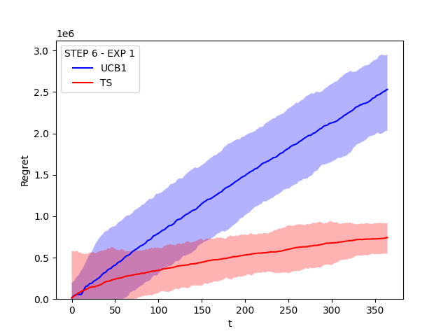
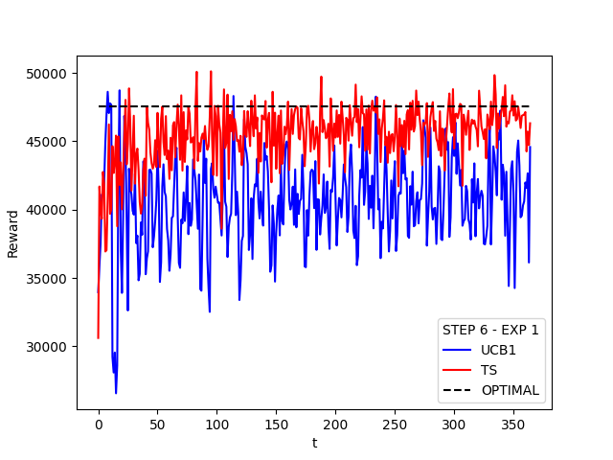
Step 6: Results (first experiment)
T = 365 days

Slide 32
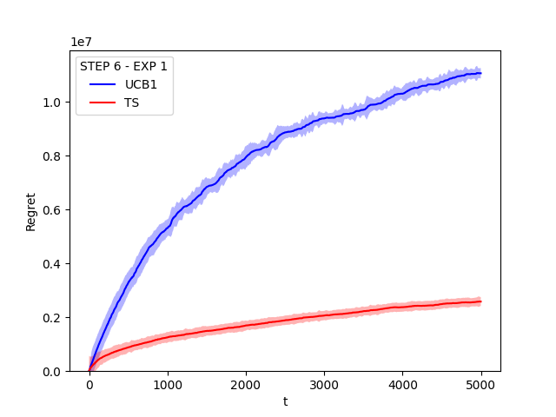
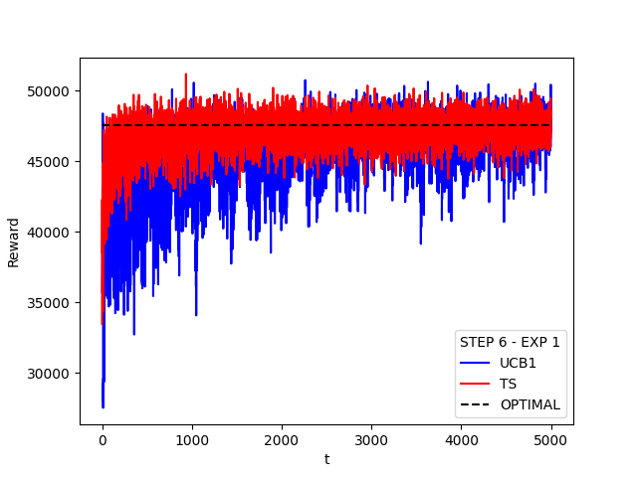
Step 6: Results (first experiment)
T = 5000 days

Slide 33
Step 6: Results (second experiment)
T = 365 days

Slide 34
Step 6: Results (second experiment)
T = 5000 days

Slide 35
Non-Stationary Conversion Rates
Phases:
The products have just been released on the market.
Standard market situation (using the same conversion rates of the stationary steps).
The products are becoming obsolete (i.e. a newer model has been released).

Slide 36
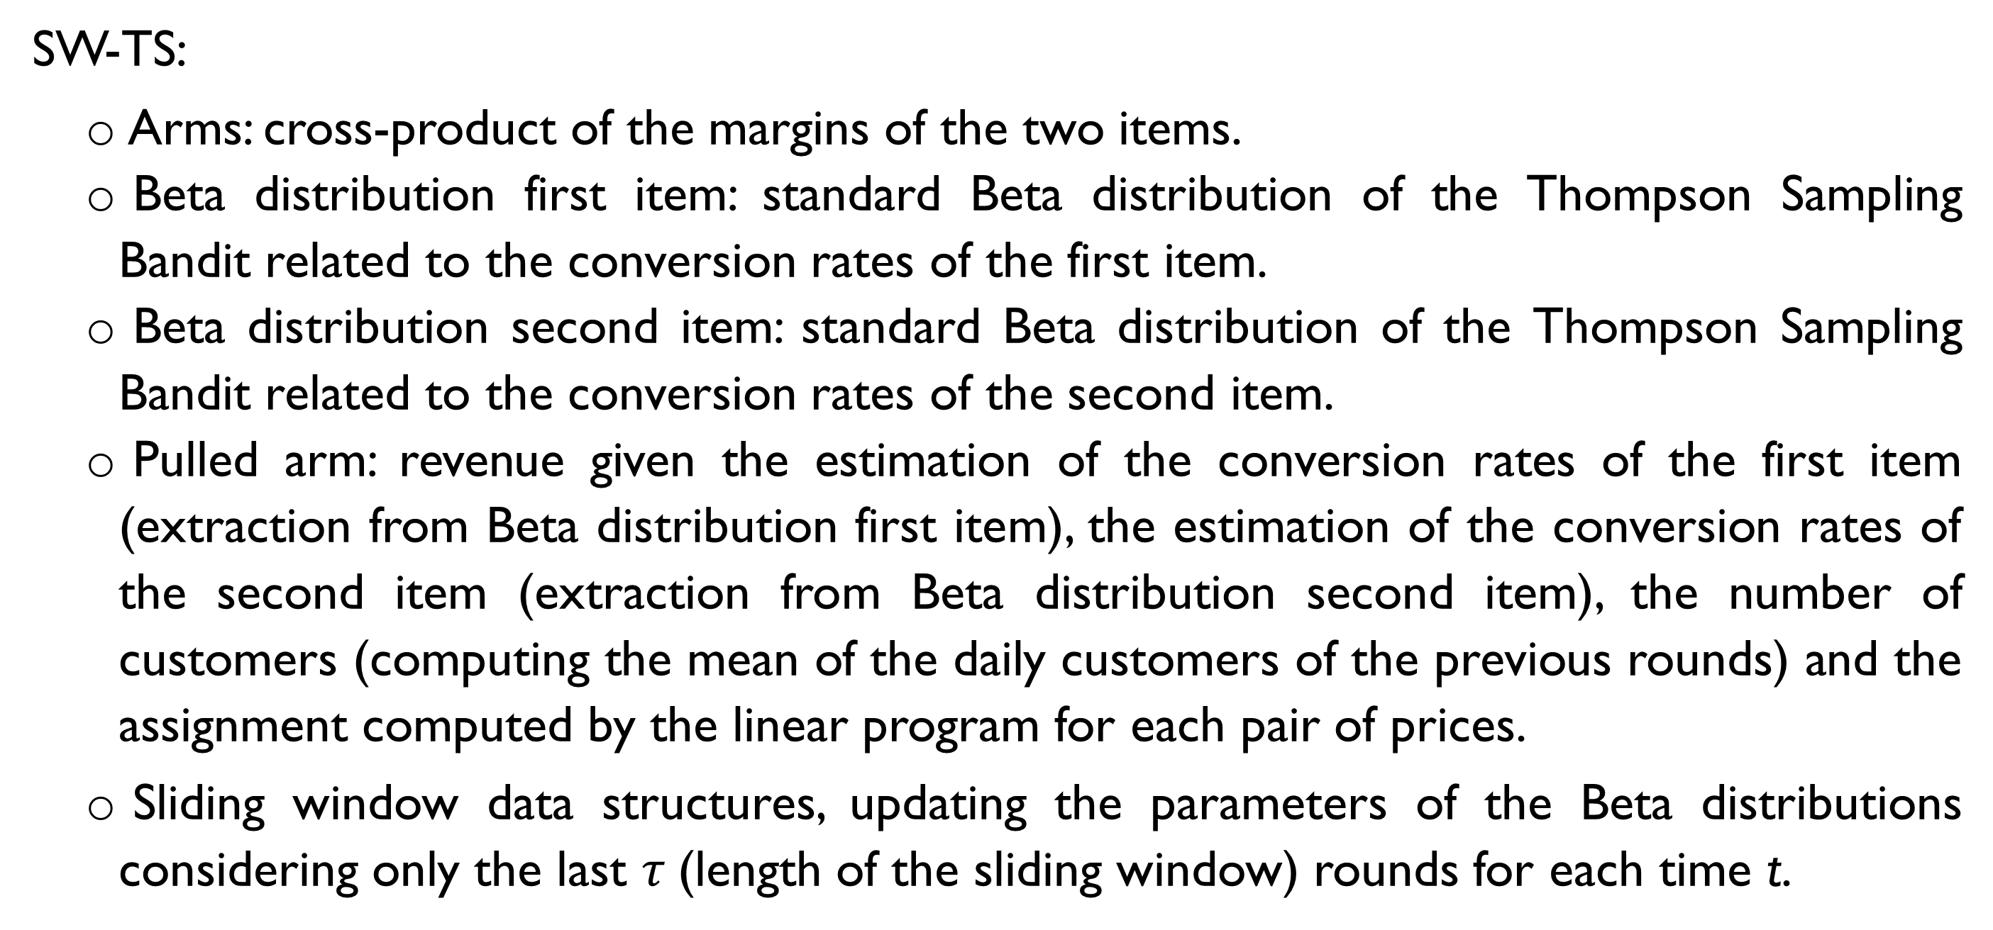
Step 7: Model
SW-TS:
Arms: cross-product of the margins of the two items.
Beta distribution first item: standard Beta distribution of the Thompson Sampling Bandit related to the conversion rates of the first item.
Beta distribution second item: standard Beta distribution of the Thompson Sampling Bandit related to the conversion rates of the second item.
Pulled arm: revenue given the estimation of the conversion rates of the first item (extraction from Beta distribution first item), the estimation of the conversion rates of the second item (extraction from Beta distribution second item), the number of customers (computing the mean of the daily customers of the previous rounds) and the assignment computed by the linear program for each pair of prices.
Sliding window data structures, updating the parameters of the Beta distributions considering only the last $τ$(length of the sliding window) rounds for each time t.

Slide 37
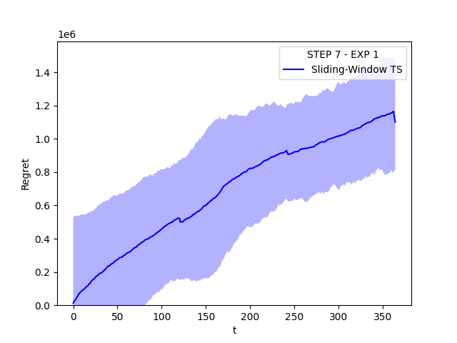
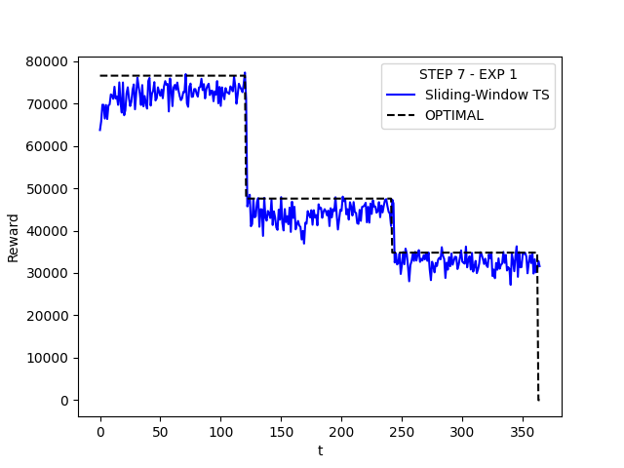
Step 7: Results (first experiment)
T = 365 days

Slide 38
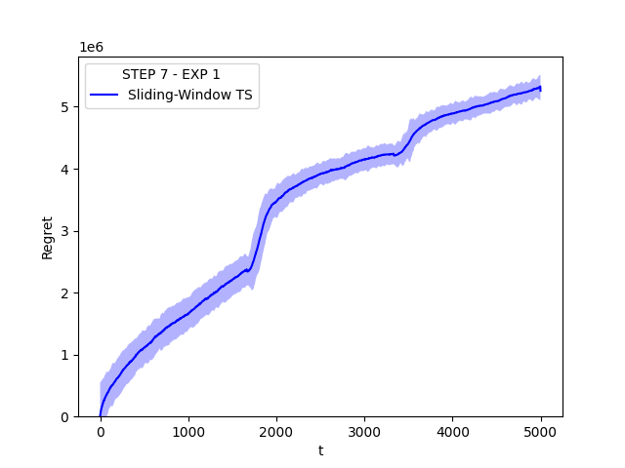
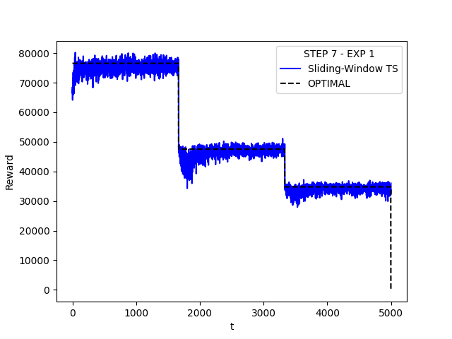
Step 7: Results (first experiment)
T = 5000 days

Slide 39
Step 7: Results (second experiment)
T = 365 days

Slide 40
Step 7: Results (second experiment)
T = 5000 days

Slide 41
Step 8: Model
UCB1-CUMSUM:
Arms: cross-product of the margins of the two items.
Empirical mean first item: estimation of the conversion rates of the first item.
Empirical mean second item: estimation of the conversion rates of the second item.
Confidence first item: standard confidence of the UCB1 Bandit related to the first item.
Confidence second item: standard confidence of the UCB1 Bandit related to the second item.
Upper bound: revenue given the estimation of the conversion rates of the first item (empirical mean first item plus confidence first item), the estimation of the conversion rates of the second item (empirical mean second item plus confidence second item), the number of customers (computing the mean of the daily customers of the previous rounds) and the assignment computed by the linear program for each pair of prices.
Change detection data structures to understand when the phases changes, using a cumulative sum approach.

Slide 42
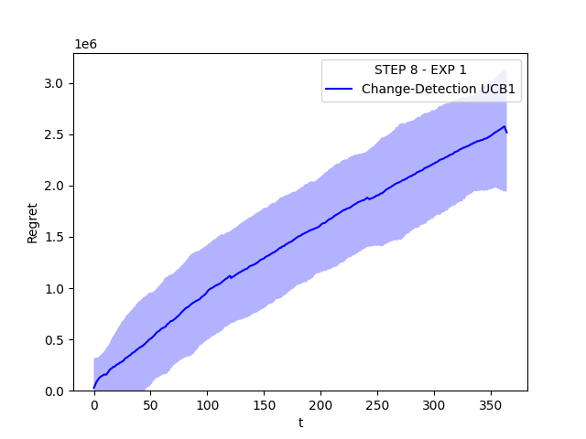
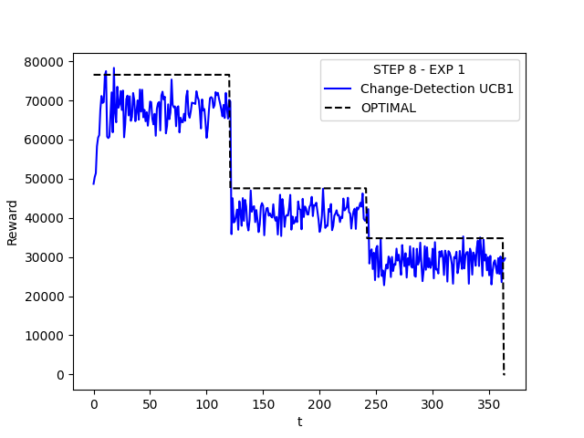
Step 8: Results (first experiment)
T = 365 days

Slide 43
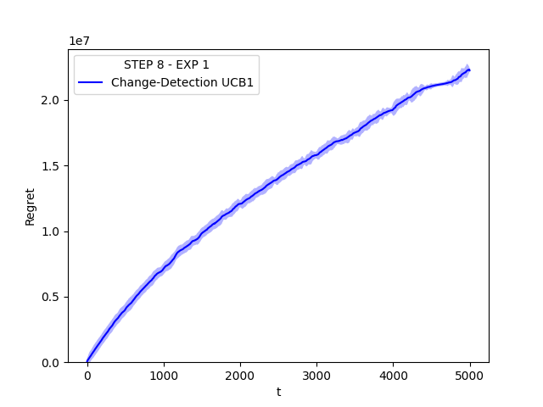
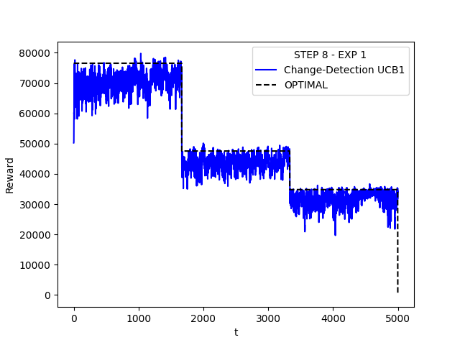
Step 8: Results (first experiment)
T = 5000 days

Slide 44
Step 8: Results (second experiment)
T = 365 days

Slide 45
Step 8: Results (second experiment)
T = 5000 days

Slide 46

Thank You!

